Slide 1
Soldier Peter‘s path through World War 1
Sabina, Anuška, Oktavija,
January 2017,
Slovenia

Slide 2
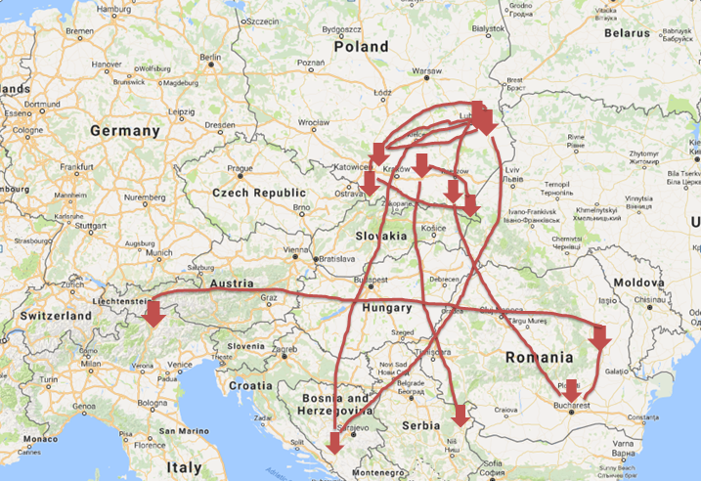
End
Beginning

Slide 3
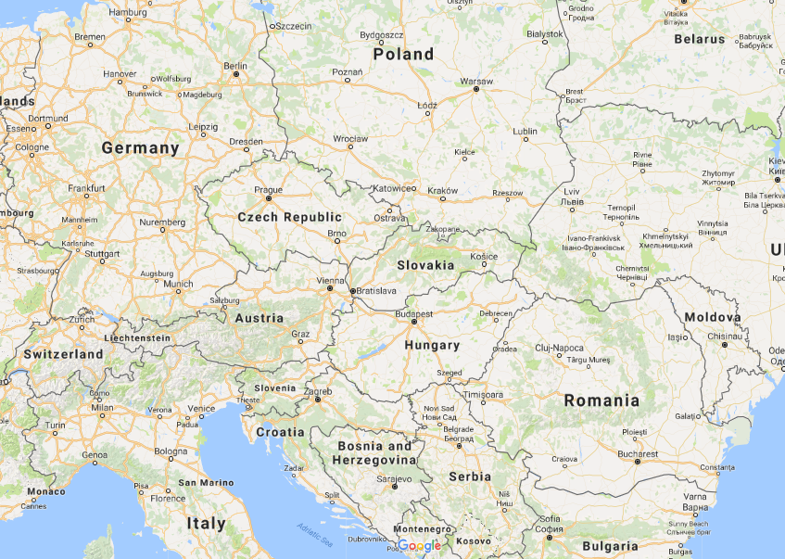
GRLJAN
28. 6. 1914
Slovenian soldier finds out that on that day Austro-Hungarian heir to the throne was murdered in Sarajevo.

Slide 4
29. 6. 1914
He leaves for Krakow for army training. From Krakow to Novy Targ after regiment.

Slide 5
WOLA RADŁOWSKA
22.12.1914
Lice spread out among soldiers. He has burned old linen.
25.12.1914
“Silent night, Holy night” has resounded, at first quietly then more and more fervently, a song that wakes the deepest and the most tender feelings. Red flames and smoke of bonfire have leaked to the dark night. Two brown horses brought presents, one for each of us.

Slide 6
GALICIA
1.2.1915
Then everybody has gathered together, because of all their other interests, no matter what their nationality was. There was hundreds of thousands Slavs in Austrian army and there was only a few of those who would be capable of treason. It’s hard to say that was easy for Slav to fight another Slav. Every rational person should be able to see that and shouldn’t judge the Slavs that live in Austro-Hungarian monarchy. Austrians didn’t approve Slovenian culture, they wanted to assimilate all Slavs.

Slide 7
MILOWKA
19. 2. 1915
They shot 363 bullets yesterday. A nice change after long time. Weather was unpleasant and cold, but they spend the day outside from 6 A.M. to 7 P.M. New artillery has shot more than 3000 grenades and shrapnels from different calibres to Russian ditch.
20.2.1915
Terrible explosions and clouds have reached up to the sky. Soldier thinks it’s right that leadership doesn’t sacrificies so much people without cogent reason. The Russians have lost a lot of power here, so they won’t amplify Carpathian front.

Slide 8
WAL
5.5.1915
There were invalid Russian lying on the field, bones and limbs without bodies. At Wal we once again passed Russian lines. Their fort looks much more comfortable and cleaner than Russian one.

Slide 9
RUDNIK, BY RIVER SANA
19. 5. 1915
Shrapnels, grenades and screaming could be heard again, but Russians wouldn’t stop so there were flying salvos above our heads. Cannons were shooting, but soldier was calm like he never has been before. They had no idea what could happen on that horrible day.

Slide 10
20 km Southeast from Lublin
14.8.1915
Prisoners were walking around almost freely and they helped with every task. Cholera has spread through the village. Millions of flies were buzzing. Everything was dirty. Soldiers slept in the field, as usual.

Slide 11
PODLESKI
26.9.1915
It was a peaceful night, but they were in full awareness, although their infantry wasn’t capable of defence. An army this weak, which was a consequence of a bad leadership couldn’t bring any victory. He pitied the Bosnians – their blood was spilled to no avail...

Slide 12
WOŁYNIAN
29. 12.1915
The holiday season has begun – Christmas tree, lights, nuts and apples. But heard was empty and dreary. He hadn’t cried. He had felt good when he was gifting his team, but after that he didn’t care again.

Slide 13
DOLŽOK
23.4.1916
On that morning the Russians greeted them. Slowly, they also had enough courage to go out and after some time there were groups of 150 or 200 man gathering in the field, chatting and laughing, offering each other cigarettes and other small things. It was like the war has ended. You could feel longing for peace and establishment of normal conditions. There wasn’t even the slightest clue of hatred. But this situation was not appropriate for that time. They couldn’t get used to this because who would be able to kill then?

Slide 14
BUCHAREST
1.2.1917
Germans were terrifying. They weren’t innocent, but Germans stole from their officers - bags of food, their property, their travelling documents. That was the most despicable german action.

Slide 15
ODOBEŞTIJ
15.2.1917
Festive days have begun. In their canteen (witch wans’t so good anyway) was a lack of meat. Spices and potatoes were also gone.

Slide 16
SV MIHAEL PRI BOZNU
18. 10.1918
Austria wasn’t stable. Wilson pushed down on Germany, which obeyed every order and every hit. The wolfs became lambs and lambs became noble hawks.
Serbia penetrated to Balkan! It was like the God wanted to prove that german arrogance can’t beat the most noble nation of the biggest heroes of the world. The war is ending, where has all begun.

